Slide 1
Chapter 3 Classes and Objects
Tian Jingbai

Slide 2
Objectives
To be able to declare classes
To understand object references
To understand the mechanism of parameter passing
To be able to use static member and instance member properly
To become familiar with the organization of classes
To understand the object life cycle and the scope of variables

Slide 3
对象的特征：
所有东西都是对象；
程序是对象的集合，通过消息通信；
每个对象都有自己的存储空间，可容纳其他对象；
每个对象都有一个类型；
同类对象接收相同的消息；
对象的接口：
方法的调用
消息：对象之间进行通信的一种规格说明;多个对象，通过消息传递来进行交互，最终完成复杂的任务
接收消息的对象、接收对象要采取的方法和方法参数

Slide 4
类的概念
类是描述对象的“基本原型”，它定义一类对象所能拥有的数据和能完成的操作。在面向对象的程序设计中，类是程序的基本单元。
相似的对象可以归并到同一个类中去，就像传统语言中的变量与类型关系一样。
程序中的对象是类的一个实例，是一个软件单元，它由一组结构化的数据和在其上的一组操作构成。

Slide 5
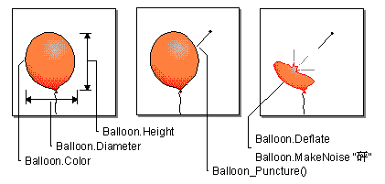
对象三要素
属性
对象的性质
方法
对象的动作
事件
对象的响应
属性 | 气球的直径、颜色、图案、充气或未充气
方法 | 放气方法（排出气球中的气体） 上升方法（放手让气球飞走）
事件 | 对刺破事件的响应是放气 对放手事件的响应是升空

Slide 6
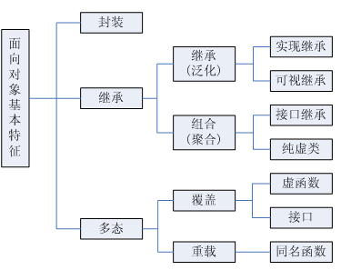
面向对象三要素
封装（encapsulation）是把数据及处理数据的行为结合起来，不被外界干扰滥用的程序设计机制
继承（inheritance）是指一个类获得另一个类的属性或方法
多态（polymorphism）是使用一个接口访问一组行为的特性，执行哪个行为由具体情况而定

Slide 7
面向对象三要素
面向对象的三大特征：
封装：解决了数据的安全性问题
继承：解决了代码的重用问题
多态：解决了程序的扩展问题

Slide 8
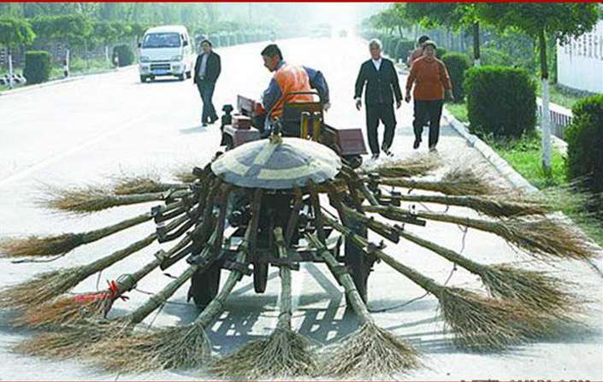
面向对象的环卫车
封装：无需知道如何运作，开动即可
继承：继承自拖拉机，实现扫地接口
多态：上班扫地，下班代步
重用：重复利用发动机的能量
多线程：多个扫把同时工作
低耦合：扫把可以换成拖把
面向构件：每个配件都可独立使用
适配器模式：只取拖拉机的动力方法
代码托管：无需垃圾管理，扫到路边即可

Slide 9
面向对象程序设计方法的优点
利用面向对象的思想求解问题，使人们的编程与实际的世界更加接近，所有的对象被赋予属性和方法，使编程更加富有人性化。同时利用OOP求解问题，具有更好的重用性、可扩展性、更易管理和维护。

Slide 10
可重用性
软件由各个模块组成，可重用性就是该软件的模块可以被重复利用，不仅用于该项目，还可用于其他项目。对于代码级，可重用性指类或者方法的重复使用，避免对于同一功能多次实现产生多余代码。可重用性是OOP的一个核心思想。OOP中的抽象、继承、封装等都可服务于可重用性。
利用可重用性构建程序，优点是显而易见，不仅减少工作量，提高工作效率；利用已有的模块进行开发，更能够提高程序质量。

Slide 11
可扩展性
可扩展性即软件或者程序能够很方便地进行修改和扩充。对于软件产品来说，修改和扩充是必不可少的，一是不断地修订保证程序的稳定；二是可以不断满足用户新的需求。由于继承、封装、多态等特性，面向对象方法可以设计出高内聚、低耦合的系统结构，使得系统更灵活，更容易扩展，而且成本较低。

Slide 12
易于管理和维护
面向过程的开发方法，都是以函数为基本单元。所以当开发项目不断扩大时，这样的函数单元将变得不计其数，显示这样是不利于管理和维护的。而使用OOP后，以类作为开发的基本模块，由于继承的存在，即使改变需求，那么维护也只是在局部模块，所以维护起来是非常方便的，成本也较低。

Slide 13
面向对象与UML建模
面向对象是人们思考现实世界的一种自然方法，也是编写计算机程序的一种自然方法，在软件的分析和设计过程中，面向对象的思想也是无处不在的。所以在构建软件的过程中，系统建模是非常关键的步骤，所以OOP也与建模紧密地结合在一起。

Slide 14
统一的软件建模语言UML
20世纪末期,发生在软件工程学界的一件大事
→面向对象软件的统一建模语言UML
OO,Coad/Yourdon,use-case法等各种理论和方法同时存在,混战了十多年,
1995年, 提出UML (Unified Modeling language)
1997年OMG投票通过,批准UML成为国际标准
进入了统一的软件建模时代!
UML具有完整的元模型(规范)体系

Slide 15
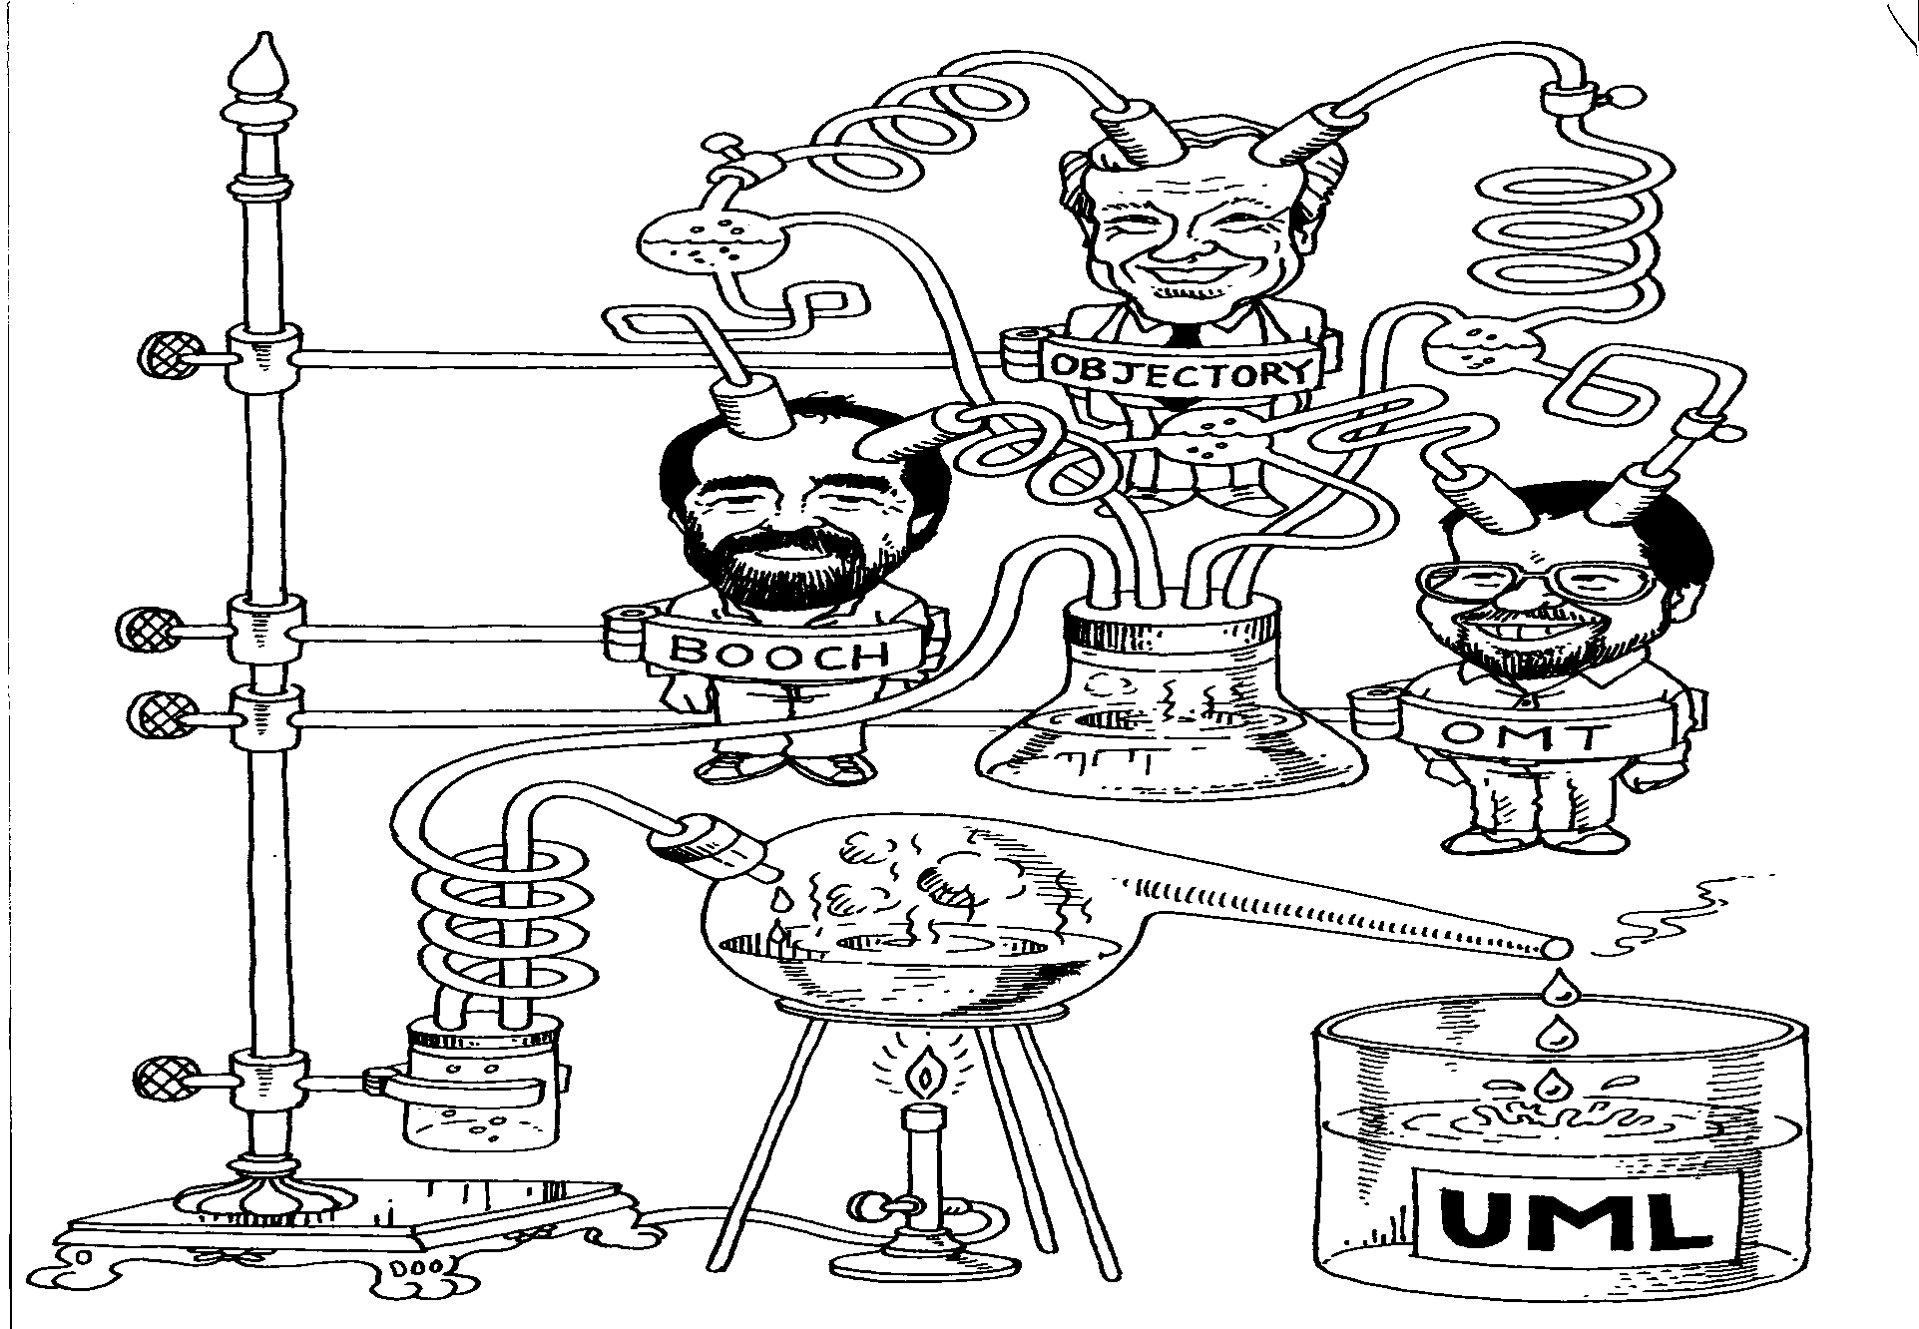
UML的形成(1)
Jacobson
OOSE
Use case
Rumbaugh

Slide 16

UML的形成(2)
Booch
Rumbaugh
Jacobson
Meyer
Fusion
Before and after
conditions
Operation descriptions,
Message numbering
Embley
Harel
Singleton classes,
High-level view
State charts
Gamma, et.al
Wirfs-Brock
Frameworks, patterns,
notes
Responsibilities
Shlaer - Mellor
Odell
Object Lifecycles
Classification

Slide 17
UML的特点
统一标准
面向对象
可视化、表达能力强
独立于过程
易掌握、易用

Slide 18
3.1 Class Declaration
An object has a unique identity, state, and behaviors.
The state of an object is represented by field字段 (also known as member variables成员变量) with their current values.
The behavior of an object is defined by a set of methods方法.

Slide 19
3.1 Class Declaration
All the qualities of a class are specified in the class declaration, which consists of
optional fields, 字段（成员变量）
optional methods, 方法
optional constructors, 构造方法
and optional member classes (inner classes). 成员类（内部类）

Slide 20
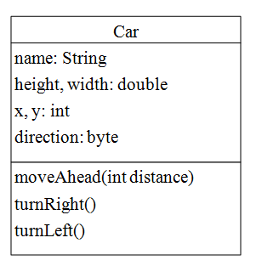
3.1 Class Declaration

Slide 21
3.1 Class Declaration
There are several kinds of variables in a class:
member variables in a class—these are also called fields; 成员变量
Variables in a method or block of code—these are called local variables; 局部变量
Variables at the head of a method—these are called parameters 参数
A class is a template for multiple objects with similar attributes and behaviors.

Slide 22
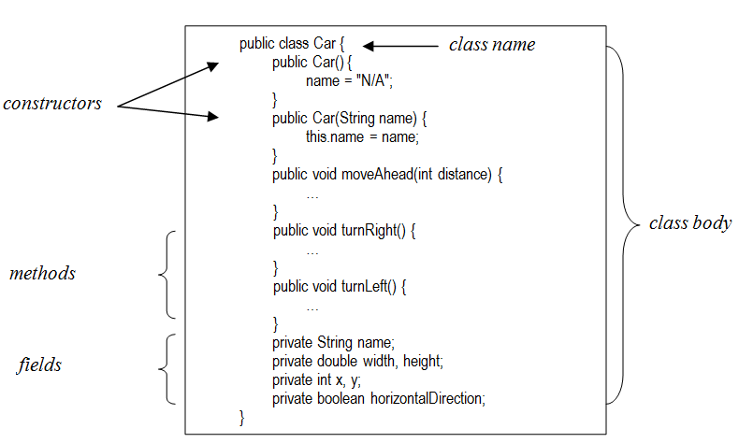
Components of the Car class

Slide 23
Method declaration 方法声明
The structure of a method includes a method signature and a code body:
<access_modifier> <return_type> <method_name> (<list_of_parameters>) {
……
}
The method‘s name and the parameter types of a method declaration comprise the method signature.方法签名
The method body, enclosed between braces, consists of the method‘s code and the declaration of local variables.方法体

Slide 24
Constructor 构造方法
A constructor is called when an instance of this class is first created.
It is used to initialize the member variables.
The constructor signature looks similar to that of a regular method.
It has a name that matches the class name and holds a list of parameters in parentheses.
However, a constructor has no return type.
Constructors are invoked using the new operator when an object is created.

Slide 25
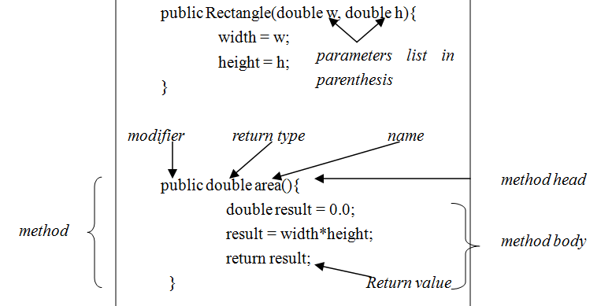
Method declaration

Slide 26

Default constructor
If there is no constructor in a class declaration, the Java compiler will create a default constructor with an empty parameter list.
For example, if there is no constructor is defined in the class Car, JVM will use the default parameterless constructor.
The default constructor calls the default parent constructor (super()) and initializes all instance variables to default value (zero for numeric types, null for object references, and false for booleans).

Slide 27
Default constructor
public class Test {
public static void main(String[] args) {
Car a = new Car();
}
}
//Car.java
class Car {
String name;
}

Slide 28
Default constructor
public class Test {
public static void main(String[] args) {
Car a = new Car(); //Compilation error
}
}
Once any constructor is defined in the class Car, there will be no constructor generated
//Car.java
class Car {
public Car (String name) {
this.name = name;
}
String name;
}

Slide 29
Initialization
class Car1 {
public Car1() {
width = 1.0;
height = 2.0;
}
private String name;
private double width, height;
private int x, y;
}
public class Test1{
public static void main(String[] args) {
Car1 a = new Car1();
}
}
class Car2 {
private String name;
private double width = 1.0, height = 2.0;
private int x, y;
}
public class Test2 {
public static void main(String[] args) {
Car2 a = new Car2();
}
}

Slide 30
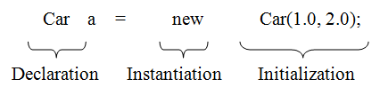
3.2 Creating Objects
An object is created from a class
Each of these statements has three parts:
declaration, 声明
instantiation 实例化
and initialization初始化

Slide 31
3.2 Creating Objects
Declaration means to associates a variable name with an object type.
Instantiation implies to create the object with the new operator.
A constructor is called to initialize the new object when the initialization performs.

Slide 32
create an object
allocate memory space for the member variables of the object,
execute the constructor
and return the reference to the new object.

Slide 33
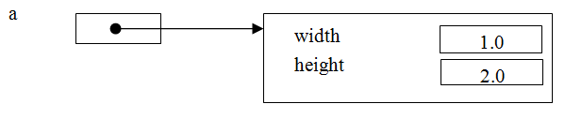
create an object
The statement:
a = new Car(1.0, 2.0);
can be read as: create an object of type Car and assign its reference to a.

Slide 34
Accessing Objects via Reference Variables
<object_reference> . <method_name>(<arguments_list>)
or:
<object_reference> . <method_name>()
Sending a message to that object is the same as invoking a method on a particular object.

Slide 35
Accessing Objects
Object member variables are accessed by their name within its own class
Example,
class Car{
double width;
double height;
public double area(){
double result = 0.0;
result = width*height;
return result;
}
}

Slide 36
Accessing Objects
Code that is outside the object's class must use an object reference or expression, followed by the dot (.) operator, followed by a member variable name
class Test{
Car a = new Car();
System.out.println("Width of a: " + a.width);
System.out.println("Height of a: " + a.height);
}

Slide 37
Java中封装的规则
用访问限制修饰符保护成员变量，通常是private（私有）。
建立public（公有）的访问方法，强制调用代码通过这些方法访问成员变量。
修饰符（Modifier）用于指定成员和方法的访问权限，可选值为public、protected和private;
或者方法的其他特性,比如abstract、final、static

Slide 38
A simple Javabean
public class Car {
private double height;
private double width;
private double length;
public double getHeight() {
return height;
}
public void setHeight(double height) {
this.height = height;
}
public double getWidth() {
return width;
}
public void setWidth(double width) {
this.width = width;
}
public double getLength() {
return length;
}
public void setLength(double length) {
this.length = length;
}
}
public class Test {
public static void main(String[] args) {
Car car = new Car();
car.setHeight(1.0);
car.Height = 1.0;
}
}

Slide 39
Object Reference this
this is a reference to the current object which is the object whose method or constructor is being called.
It refers to the newly created object in constructors, or refers to the object that a method belongs to in the method.

Slide 40
this
public class Car {
public Car(double width, double height) {
this.width = width;
this.height = height;
}
…
private double width, height;
}
this is used to distinguish member variables from parameters in the constructor of the class Car declaration

Slide 41
this
By this, a constructor can invoke another constructor
Note that this(0.0, 0.0); must be the first statement in the constructor in this case.
public class Car {
public Car(double width, double height) {
this.width = width;
this.height = height;
}
public Car() {
this(0.0, 0.0);
}
…
private double width, height;
}

Slide 42
3.5 Parameter Passing
The list of variables in a method head declaration are the parameters 形参
The actual values that are passed when the method is invoked are called the arguments 实参
The arguments must match the corresponding parameters in type and order.

Slide 43
The typical method call sequence
1. Evaluate arguments left-to-right. （求值）
If an argument is a simple variable or a literal value, there is no need to evaluate it.
When an expression is used（使用表达式的情况）, the expression must be evaluated before the call can be made.
2. When a method is called, a temporary piece of memory is required to store the following information:
parameter and local variable storage,
where to continue execution when the called method returns
and any other working storage needed by the method.

Slide 44
The typical method call sequence
3. Initialize the parameters.
When the arguments are evaluated, they are assigned to the local parameters in the called method.
4. Execute the method.
Execution starts with the first statement and continues as normal.
5. Return from the method.
When a return statement is encountered, or the end of a void method is reached, the method returns.
For non-void methods, the return value is passed back to the calling method.
Execution is continued in the calling method immediately following where the call took place.

Slide 45
Any changes to the values of the parameters exist only within the scope of the method.参数的改变范围只限于方法内部
However, in the case of reference type, the values of the object‘s fields can be changed in the method.对于引用类型，对象的值在方法内可以被改变

Slide 46
Example
public class Point {
public Point() {
}
public Point(int xValue, int yValue) {
x = xValue;
y = yValue;
}
// return x from coordinate pair
public int getX() {
return x;
}
// return y from coordinate pair
public int getY() {
return y;
}
public void setXY(int x, int y) {
this.x = x;
this.y = y;
}
public String toString() {
return "[" + getX() + ", " + getY() + "]";
}
private int x; // x part of coordinate pair
private int y; // y part of coordinate pair
}
public class Car {
public Car() {
this(0, 0);
}
public Car(double width, double height) {
this.width = width;
this.height = height;
}
public double area() {
return width * height;
}
public void setLocation(Point p){
currentLocation = p;
}
public void setLocation(int x, int y){
Point p = new Point(x, y);
currentLocation = p;
}
private double width, height;
private Point currentLocation;
//The current location of this object
}

Slide 47
parameter passing
public class ParaDemo {
public static void main(String args[]) {
Car a = new Car(3,6);
a.setLocation(10, 20);
}
After invoking setLocation(10, 20), the parameter x holds 10 and y holds 20.

Slide 48
public class ParaDemo {
public static void main(String args[]) {
Car a = new Car(3, 6);
Point aPoint = new Point(10, 20);
a.setLocation(aPoint);
}
}
}
Assume setLocation() is invoked as below.
public void setLocation(Point p){
>
currentLocation = p;
}

Slide 49
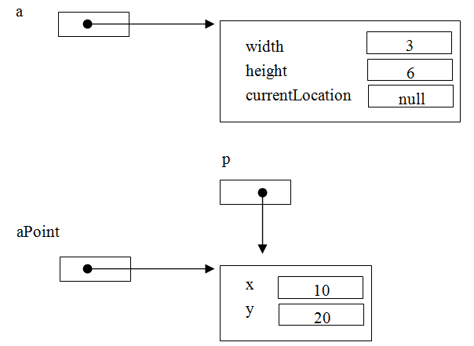

Slide 50
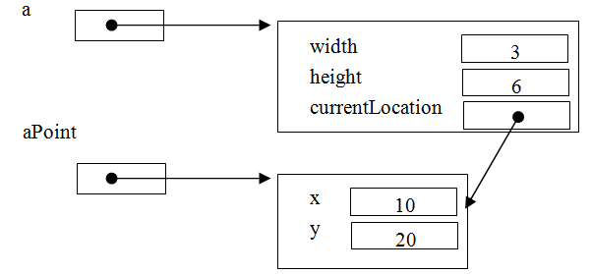
public static void main(String args[]) {
Car a = new Car(3,6);
Point aPoint = new Point(10,20);
a.setLocation(aPoint);
>
}
After the call a.setLocation(aPoint); control returns to the main method,

Slide 51
pass-by-value
For an argument of a primitive type, the argument's value is passed.
For an argument of an reference type, the value of the argument contains a reference to an object and this reference is passed to the method.

Slide 52
Example
public class ArrayAsPara {
public static void main(String[] args) {
int[] a = {2,3};
swap(a[0],a[1]);
exchange(a);
}
static void swap(int x, int y){
int temp = x; x = y; y = temp;
}
static void exchange(int[] a){
int temp = a[0]; a[0] = a[1]; a[1] = temp;
}
}

Slide 53
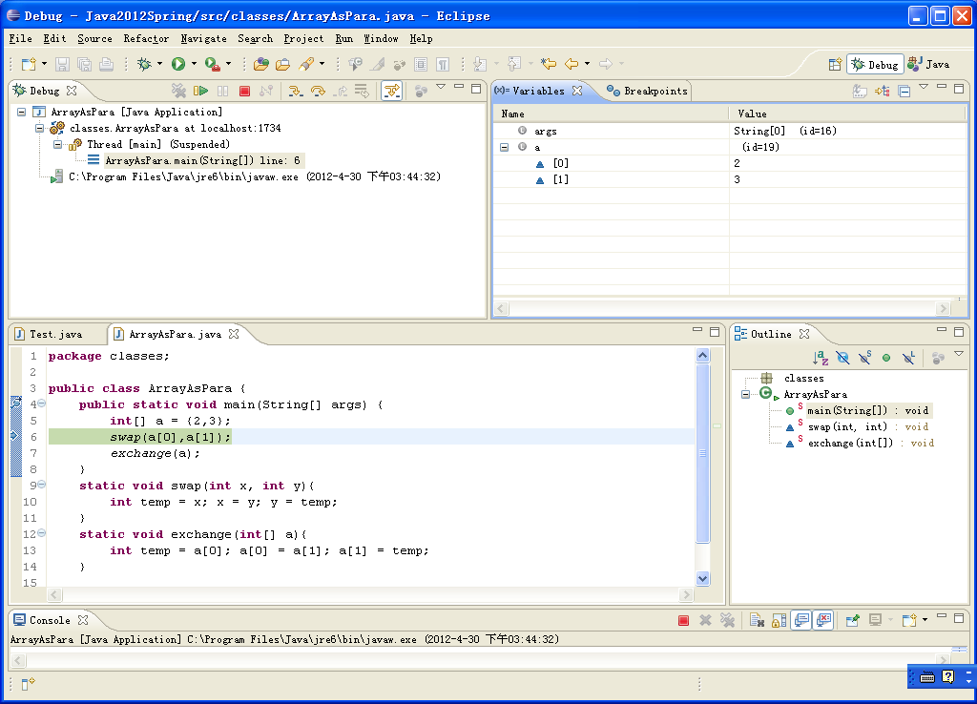
The content of the array a before invoking swap()

Slide 54
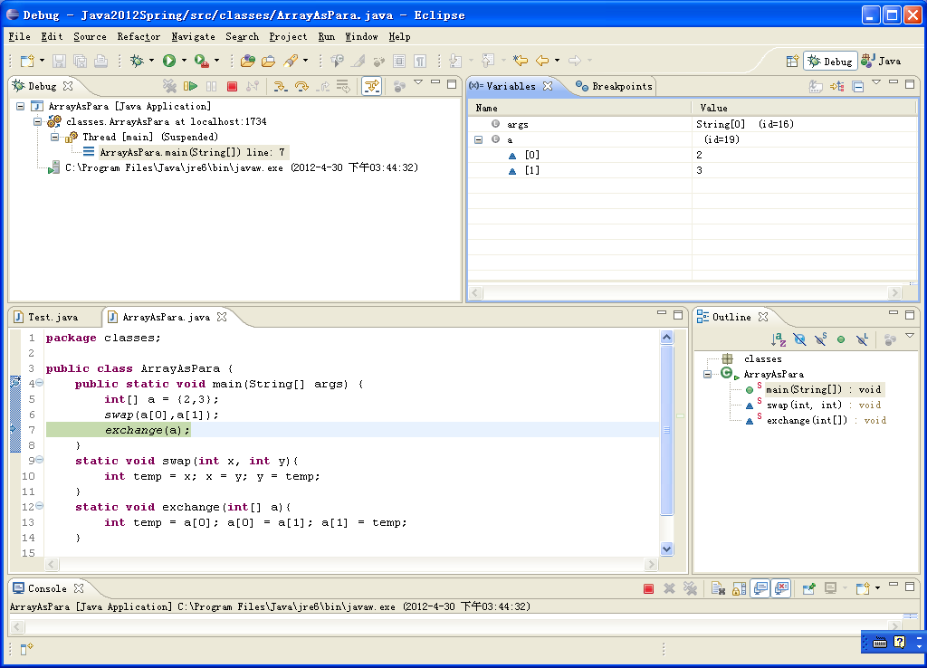
The content of the array a after invoking swap()

Slide 55
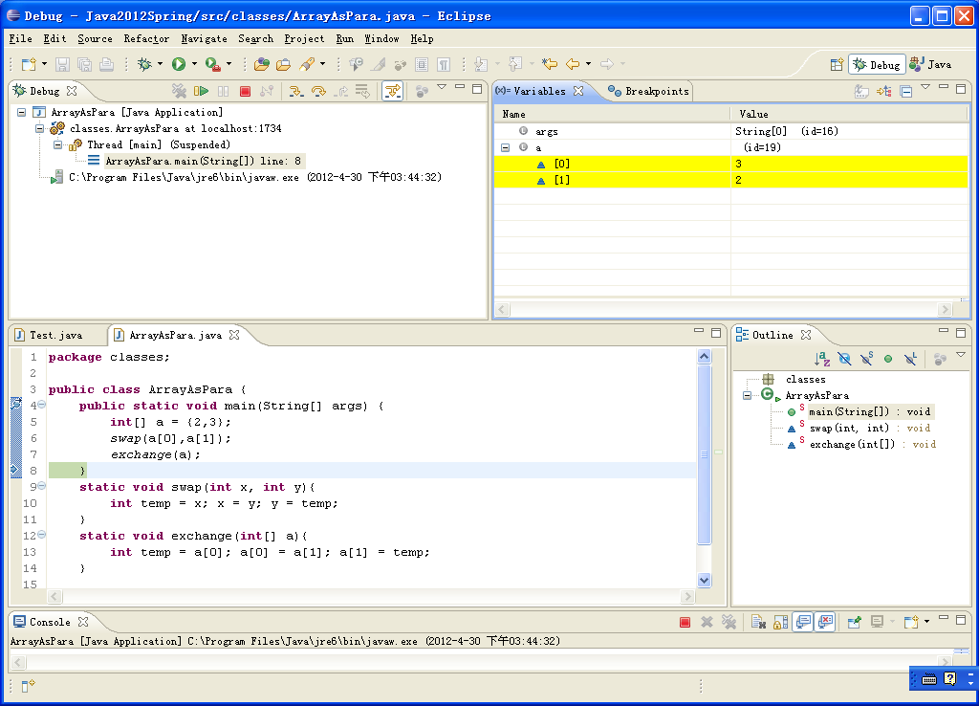
The content of the array a after invoking exchange()

Slide 56
3.6 Returning from methods
void methods:
return;
non-void methods:
return <value>;

Slide 57
Example
public class ReturnDemo {
public static void main(String[] args) {
A a = new A();
B b1 = a.getB();
b1.say();
}
}
class A {
public B getB(){
B b= new B();
return b;
}
}
class B{
public void say(){
System.out.println("I am B.");
}
}

Slide 58
Method overloading重载
public void setLocation(Point p){
currentLocation = p;
}
public void setLocation(int x, int y){
Point p = new Point(x, y);
currentLocation = p;
}
方法名相同，参数列表不同
Same name
Different parameter list

Slide 59
method overloading
java.io.PrintWriter.println()
java.io.PrintWriter.println(boolean)
java.io.PrintWriter.println(char)
java.io.PrintWriter.println(char[])
java.io.PrintWriter.println(double)
java.io.PrintWriter.println(float)
java.io.PrintWriter.println(int)
java.io.PrintWriter.println(java.lang.Object)
java.io.PrintWriter.println(java.lang.String)
java.io.PrintWriter.println(long)

Slide 60
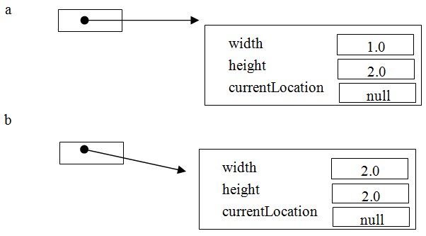
3.8 Class Variables and Instance Variables
The states of object a and b

Slide 61
class variables and instance variables
To provide public resources visited by objects
（对象间通用内容）使用static variables and methods
A static variable or method is also called a class variable or method（类/静态变量或方法）, since it belongs to the class itself rather than to an instance of that class.
The non-static member variables are referred to as instance variables （实例变量）since the values belong to a unique instance of the class. The instance variable has the same life cycle as the object it belongs to.

Slide 62
Example
class Car {
public Car() {
this.width = 3;
this.height = 4;
}
public void notify(String note) {
Car.note = note;
}
public String response() {
return Car.note;
}
public static String note; // shared by the all Car’s instances.
double width, height;
}

Slide 63
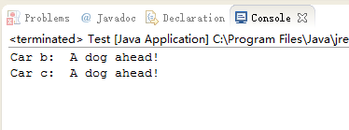
Example
public class StaticViariableDemo {
public static void main(String args[]) {
Car a = new Car();
Car b = new Car();
Car c = new Car();
a.notify("A dog ahead!");
System.out.println("Car b: " + b.response());
System.out.println("Car c: " + c.response());
}
}

Slide 64
access static variables
We can access the static variables directly using the name of the class, as in:
Car.note = "Dog!";
The general form is:
<class_name>.<static_variable>

Slide 65
class variables and instance variables
There are three ways to initialize instance variables:
Declaration声明
Creation 构造方法
and Invoking a method 普通方法

Slide 66
class variables and instance variables
1. Declaration
public class A {
public void aMethod() {
}
private int aMember = 1;
}
2. Constructor
class A {
A(int i) {
aMember = i;
}
private int aMember;
}

Slide 67
class variables and instance variables
3. Method
class A {
void f() {
aMember = 0;
}
int aMember;
}
However, static variables cannot be initialized by constructors. 静态方法无法被构造方法初始化
Initialization can be done by declaration or a regular method.

Slide 68
3.9 Class Methods and Instance Methods
The typical usage of static methods is to do some kind of generic calculation such as methods in Math and java.util.Random. A method is declared as "static" by the static modifier.
Static methods are invoked with the class name, without the need for creating an instance of the class, as in:
<class_name>.<method_name>(<argument_list>)

Slide 69
Example
public class Thermograph{
public static int centigradeToFahrenheit(int cent){
return cent * 9 / 5 + 32;
}
}
Thermograph.centigradeToFahrenheit(36);

Slide 70
3.9 Class Methods and Instance Methods
The static methods can only access static variables, while instance methods can access static and instance variables.

Slide 71
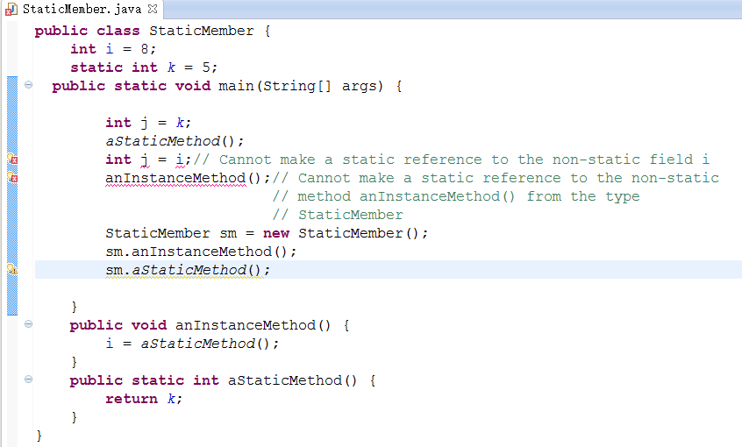

Slide 72
3.9 Class Methods and Instance Methods
In summary,
a static method is a method which belongs to the class and not to the object(instance).
A static method can access only static data.
It cannot access non-static data (instance variables).
A static method can call only other static methods and cannot call a non-static method.
A static method can be accessed directly by the class name and does not need any object reference
A variable or method that is dependent on a specific instance of the class should be an instance variable or method.
A variable or method that does not depend on a specific instance of the class should be a static variable or method.

Slide 73
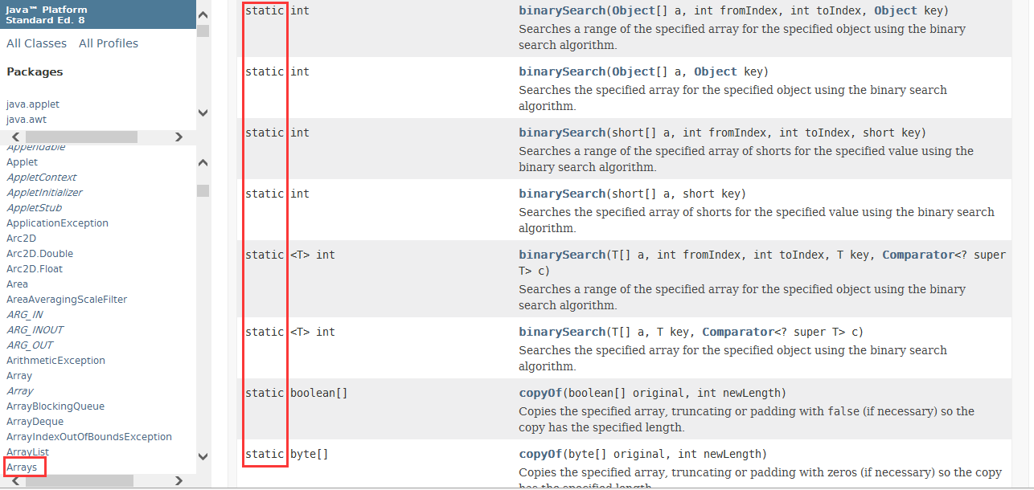

Slide 74
A static block
A static block is a block of statements inside a Java class that will be executed when a class is first loaded into the JVM. A static block helps to initialize the static data members, just as constructors help to initialize instance members.
Class A{
static {
//Statements here
}
}

Slide 75
3.10 The Scope of Variables
local variables, 局部变量
instance variables 实例变量
and class variables 类变量

Slide 76
public class Car {
public Car() {
this(0, 0);
}
public Car(double width, double height) { //Parameters
this.width = width;
this.height = height;
}
public void setLocation(Point p){ //Parameters
currentLocation = p;
}
public void setLocation(int x, int y){
Point p = new Point(x, y); // Local Variables
currentLocation = p;
}
public static int rectsCount = 0; // Class Variables
private double width, height; // Instance variables
private Point currentLocation;
}

Slide 77
3.10 The Scope of Variables
Local variables are declared in a method, constructor, or block. When a method is entered, the local variables are created; when the method exits, they disappear.
Parameters are essentially local variables that are initialized from the actual parameters.
Local variables are not visible outside the method.

Slide 78
3.10 The Scope of Variables
Instance variables are declared in a class, but outside a method.
They are also called field or member variables.
An instance variable is created when an object is created and destroyed when the object is destroyed.

Slide 79
3.10 The Scope of Variables
Class/static variables are declared with the static keyword in a class, but outside a method.
There is only one copy per class, regardless of how many objects are created from it.
Class variables are created when the program starts and destroyed when the program terminates.

Slide 80
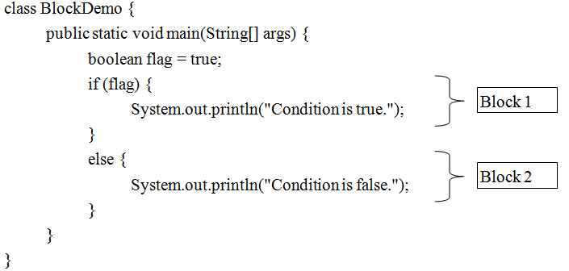
3.10 The Scope of Variables
The variables declared in a block can only be accessed within the block.

Slide 81
3.10 The Scope of Variables
Local variables (including formal parameters) are only be accessed in the method, constructor, or block in which they are declared.

Slide 82
3.10 The Scope of Variables
Instance variables are available to all methods in the class.
No other class can access private instance variables.
If an instance variable is declared as public, it can be accessed from any class.
By default, if there are no access modifiers (private, public, protected) preceding a variable declaration, the variable can be seen by any class in the same package.(默认访问权限)
 | Same class | Same package | Descendant classes in different packages | Different packages
Private | √
Default | √ | √
Protected | √ | √ | √
Public | √ | √ | √ | √

Slide 83
3.10 The Scope of Variables
Java does not provide initial values for local variables.
局部变量不会被赋初始值
They must be assigned a value before their first use.
In contrast, instance variables and static variables are initialized by Java automatically: zero for numbers, false for booleans, or null for object references.

Slide 84
public class ScopeOfVariable {
public static void main(String args[]) {
int i;
for (i = 0; i < 3; i++) {
int x = 0;
// x is a block variable. It is initialized each time block is entered
x = x + 10;
System.out.println("x in the for loop: " + x);
}
System.out.println("i is now: " + i);
System.out.println("x in the class: " + x);
}
static void aMethod(){
int x = 1; // x is a local variable
System.out.println("x in aMethod: " + x);
}
static int x = 100; //static variable
}
x in the for loop: 10
x in the for loop: 10
x in the for loop: 10
i is now: 3
x in the class: 100

Slide 85
3.11Garbage Collection垃圾回收
Garbage collection is the process of automatically collecting memory blocks that are no longer being used ("garbage"), and making them available for further use.
Garbage consists of objects that can't be referenced by anyone.

Slide 86
3.11Garbage Collection
public void process(){
Car a = new Car();
// Processing on the Object.
a = null;
}

Slide 87
3.12 Reflection反射
Reflection is a mechanism that allows a Java program to acquire information about a class at runtime.

Slide 88
3.12 Reflection
public class Test {
public static void main(String[] args) {
Car a = new Car();
Class c = a.getClass();
System.out.println("This is : " + c);
System.out.println("The class name : " + c.getName());
}
}
class Car{
public void aMethod() {
}
private int aMember = 1;
}
This is : class Car
The class name : Car

Slide 89
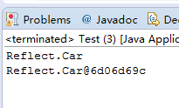
3.12 Reflection
Car car1=new Car();
System.out.println(car1.getClass().getName());
Car car2 = (Car) Class.forName(car1.getClass().getName()).newInstance();
System.out.println(car2);
The classes Class, Method and Constructor are all used to find information about a class.

Slide 90
Example
import java.lang.reflect.*;
public class AboutClass {
public static void about(Object object) {
Class c = object.getClass();
System.out.println(c);
// The constructors in the class c are printed first.
Constructor[] constructors = c.getConstructors();
for (Constructor cs : constructors) {
String line = "C ";
// Return the name of the constructor as a string
line += cs.getName() + "(";
// Return an array of instances of Class representing the parameters to the constructor
Class[] parameterTypes = cs.getParameterTypes();
for (int i = 0; i < parameterTypes.length; i++) {
line += parameterTypes[i].getName();
if (i != parameterTypes.length - 1)
line += ", ";
}
line += ")";
System.out.println(line);
}
Constructor<?> cons[]=demo.getConstructors();
try{
per1=(Person)cons[0].newInstance();
per2=(Person)cons[1].newInstance("Rollen");
per3=(Person)cons[2].newInstance(20);
per4=(Person)cons[3].newInstance("Rollen",20);

Slide 91
Example
// The methods in the class c are listed.
Method[] methods = c.getMethods();
for (Method method : methods) {
String line = "M ";
Class returnType = method.getReturnType();
line += returnType.getName() + " " + method.getName() + "(";
Class[] parameterTypes = method.getParameterTypes();
for (int i = 0; i < parameterTypes.length; i++) {
line += parameterTypes[i].getName();
if (i != parameterTypes.length - 1)
line += ", ";
}
line += ")";
System.out.println(line);
}
}
}
Method method = obj.getClass().getMethod("get");
System.out.println(method.invoke(obj));

Slide 92
Example
This is : class Car
The class name : Car
class Car
M void aMethod()
M void wait()
M void wait(long, int)
M void wait(long)
M boolean equals(java.lang.Object)
M java.lang.String toString()
M int hashCode()
M java.lang.Class getClass()
M void notify()
M void notifyAll()

Slide 93
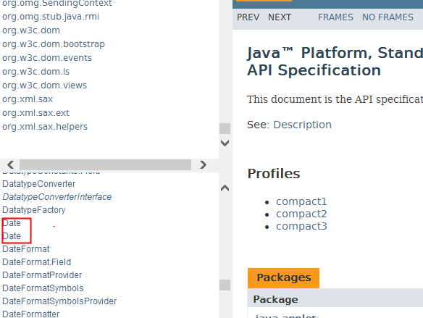
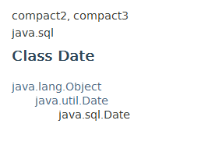
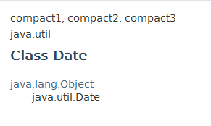
3.13 Code Organization
A package 包 is a group of related types (classes, interfaces …).
In addition to organizing classes in a clearly defined manner, packages also prevent name collisions, that is, classes come from different sources with the same names. 避免重名
Java packages make it possible to use classes with the same name but declared in different packages.

Slide 94
Java API
Java provides a rich set of pre-written classes 预定义类, giving programmers an existing set of application programming interfaces.
An API library 类库 of code exists to support networking, graphics, and general language routines; each major category being organized by packages.
One of the most important packages of all is java.lang.

Slide 95
Java API
Inside java.lang are the classes that represent primitive data types (such as int & char), as well as more complex classes such as String, Math, Threads, and even the System class from which we obtain the input and output streams.

Slide 96
Java API
java.util contains the collections framework, legacy collection classes, event model, date and time facilities, internationalization, and miscellaneous utility classes ( Calendar, Date, Scanner, Stack, Vector, Set, Queue).

Slide 97
Java API
java.io provides for system input and output through data streams, serialization and the file system. For instance, File, InputStream, OutputStream, Reader, Writer.
java.swing provides a set of "lightweight" GUI components such as JButton, JComboBox.

Slide 98
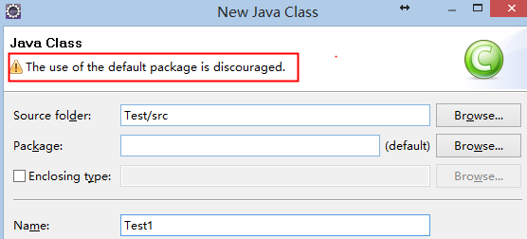
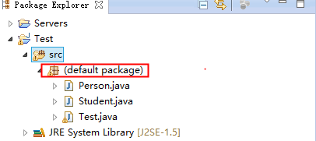
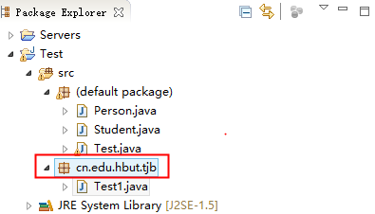
Package Customs
It is good practice to group your java code into different packages.
There are two steps to use package:
package declaration 包声明
package reference 包引用

Slide 99
Declaration
package cn.edu.hbut.java;
public class A {
…
}
All the classes and interface declared in this file belong to the package
There is only one package statement in a source file. In addition, it must be the first statement.

Slide 100
Declaration
The Java compiler creates corresponding folders for the declared package.
For example, cn.edu.hbut.java has the counterpart cn\edu\hbut\java in the disk file system. All the classes and interfaces are stored in these folders.

Slide 101
Declaration
Package names are written in all lowercase and start with a reversed Internet domain name.
the Internet domain name for our laboratory may be:
cloud.hbut.edu.cn
Then, the packages should start with:
cn.edu.hbut.cloud.

Slide 102
Reference
There are three approaches to using package members:
refer to the member by its fully qualified name, 全名引用
import the package member, 引用相关类
and import the member‘s entire package.引用整个包

Slide 103
Reference
For example, suppose there is a class E in hebtu.cs.dd.packtwo which needs to access class A in hebtu.cs.dd.oop:
package hebtu.cs.dd.packtwo;
class E {
void accessByOtherClassInOtherPackage() {
hebtu.cs.dd.oop.A a = new hebtu.cs.dd.oop.A();
…
}

Slide 104
Reference
the second approach imports the member or its package and then uses its name without any prefix.
package hebtu.cs.dd.packtwo;
import hebtu.cs.dd.oop.A;
class E {
void accessByOtherClassInOtherPackage() {
A a = new A();
…
}

Slide 105
Reference
To use many types from a package, it is convenient to import the entire package.
import hebtu.cs.dd.oop.*;
means import all the classes in package hebtu.cs.dd.oop.

Slide 106
Reference
The Java compiler will import automatically three packages: java.lang, the default anonymous package and the current package which is the package declared in the current source file.
The import directive tells the compiler where to look for the class definitions when it comes across a class that it cannot find in the default java.lang package.
Note that the import statement must appear after the package declaration and before the class declaration.

Slide 107
package cn.edu.hbut.tjb.entities;
public class employee{
private String name;
private double salary;
public employee(String n , double m){
name=n; salary=m;
}
public String getname(){
return name;
}
public double getsalary(){
return salary;
}
}

Slide 108
package cn.edu.hbut.tjb.application;
import cn.edu.hbut.entities.employee;
public class test{
public static void main(String args[ ]){
employee a = new employee(“王玲”,3000);
System.out.println(a.getname( ));
System.out.println(a.getsalary( ));
}
}

